Slide 1



Comparative Analysis of ARIMA and LSTM Models for Predicting Stock Prices in the Spanish Banking Sector
Presented By: Miloš Trifunović
Student : Miloš Trifunović
Under the Guidance of: Shanthi Iyer
Name of the course: Master In Data Science
1

Slide 2
Introduction
This presentation embarks on a comparative analysis of ARIMA and LSTM models for forecasting stock prices in the Spanish banking sector.
The research evaluates these models' performance, navigating the complexities of financial forecasting to establish a benchmark for analytics within the banking domain.
2

Slide 3
ARIMA and LSTM
Autoregressive Integrated Moving Average (ARIMA) model is a statistical model that leverages time series data to forecast future trends.
Long-Short-Term-Memory (LSTM) model is a subtype of Recurrent Neural Networks used for sequence data, an essential aspect of financial time series.
3

Slide 4
Background
Intersecting Domains:
combines economics, mathematics, and technology
Focus Area:
targets the Spanish banking sector, a crucial part of the global financial system.
Comparative Analysis:
explores ARIMA and LSTM models.
Novelty:
first to examine these predictive models in the context of Spanish banks
4

Slide 5
Problem Statement
The gap in comparative research on effective forecasting models for the Spanish banking sector
5

Slide 6
Objectives
To conduct a comparative analysis of ARIMA and LSTM models in stock price prediction.
To investigate the impact of RSI on LSTM model accuracy.
To optimize ARIMA and LSTM models specifically for the Spanish banking context.
To provide valuable insights into the field of financial econometrics.
6

Slide 7
Aim of the Research
The research aims to determine the more effective model for predicting stock prices in the Spanish banking sector and address the critical gap in the literature.
7

Slide 8
Research Questions
How do ARIMA and LSTM models perform in predicting the stock prices of large-cap Spanish banks?
How does the use of closing price as the sole feature in the ARIMA model impact its predictive accuracy compared to the broader feature set in the LSTM model?
What are the optimal parameter settings for ARIMA and LSTM models to maximize their predictive accuracy for large-cap Spanish bank stocks?
8

Slide 9
Literature Review
Citation | Data | Environment | Critique/Gap | Conclusion
Kobiela et al. (2022) | US Stock Exchange, NASDAQ | Financial markets | limited to NASDAQ, questioning ARIMA's performance in markets like the Spanish banking sector. | ARIMA outperforms LSTM in long-term forecasts with historical price as the main feature.
Alzheeva and Kochkarov (2020) | Russian Stock Exchange | Financial markets | Focuses solely on the Russian market; untested LSTM model versatility in banking across different regions. | LSTM model demonstrates superior performance with 65% less RMSE error than ARIMA, indicating LSTM's enhanced quality in time series prediction.
9

Slide 10
Literature Review
Citation | Data | Environment | Critique/Gap | Conclusion
Siami-Namini, Tavakoli, and Namin (2018) | US Stock Exchange, NASDAQ | Financial markets | Demonstrates LSTM's accuracy in NASDAQ but lacks sector-specific insights, especially in banking. | LSTM significantly outperforms ARIMA, with error rates reduction between 84% to 87%
Agrawal, Khan, and Shukla (2019) | Indian Stock Exchange | Financial markets | Innovative use of technical indicators in LSTM models not explored in the Spanish market. | Using correlation tensors with adaptive Stock Technical Indicators in LSTM provided a more accurate and efficient forecasting method
10

Slide 11
Literature Review
Citation | Data | Environment | Critique/Gap | Conclusion
Wong, Manzur, and Chew (2002) | Singapore Stock Exchange | Financial markets | Profitability of technical indicators is limited to the Singaporean market. | The study found that technical indicators, Moving Average and RSI, can be used to generate significantly positive returns
Mondal, Shit, Goswami (2014) | Indian Stock Exchange | Financial markets | ARIMA's effectiveness shown without delving into the integration of technical indicators or comparison with models like LSTM | ARIMA model demonstrated high effectiveness in forecasting stock prices across various sectors, with model accuracy being sector-specific.
11

Slide 12
Challenges in Stock Price Forecasting
Market Volatility: The Spanish banking sector is characterized by high volatility, introducing unpredictability into forecasting efforts.
Research Gap: A notable gap in research specifically addressing stock price prediction in Spanish markets
Overfitting: The complexity of financial data can lead to overfitting, reducing models' ability to generalize to new data.
Regulatory Impacts: Changes in banking regulations and economic policies can significantly influence stock prices, adding complexity to predictions.
12

Slide 13
Methodology
Preprocessing
and
EDA
Model
Optimization
Validation
and
Testing
Comparative
Analysis
Data Collection
Model
Development
All processes except Data Collection were implemented using Python and Jupyter Notebook
13

Slide 14
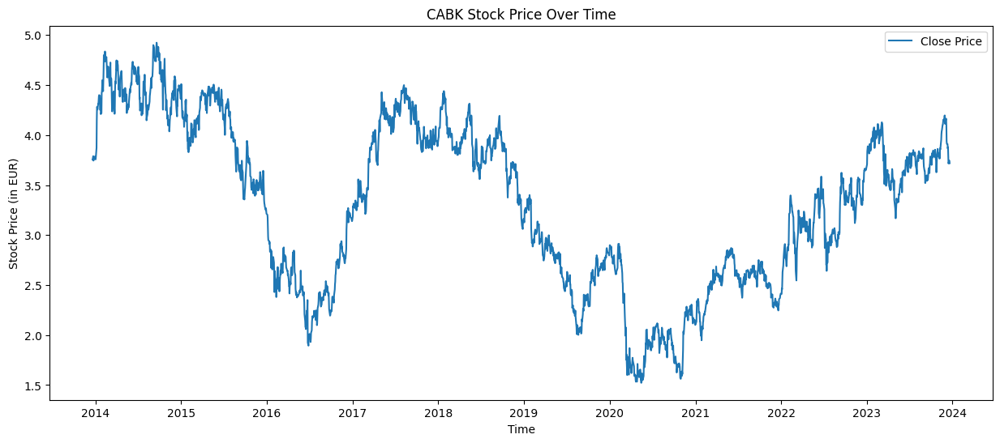
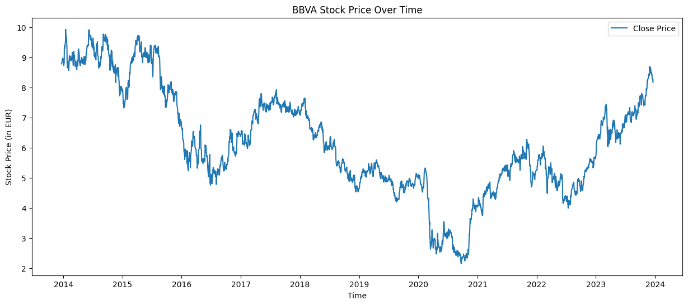
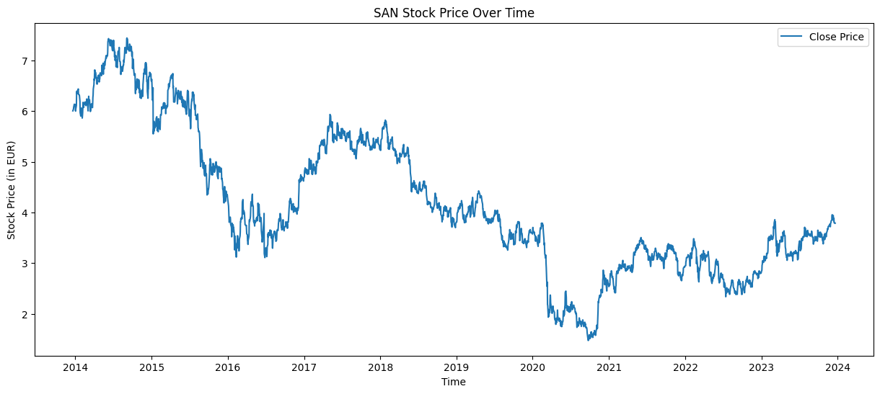
Exploratory Data Analysis
14

Slide 15
Model Building and Optimization
ARIMA Model
CLOSE price was used as a solo feature
Implemented differencing to address non-stationarity in stock price data
auto_arima library was used to find the optimal parameters for the ARIMA models
Model rigorously tested for autocorrelation in residuals through Ljung-Box test
LSTM Model
CLOSE price was used as a solo feature, then RSI was incorporated as a second feature
Initial model architecture was implemented
Hyperparameter tunning was performed to find the optimal parameters
Reduction of Mean Squared Error (MSE) and improving prediction accuracy
15

Slide 16
Optimal Parameters
ARIMA Model
ARIMA(0, 1, 0)
LSTM One Feature
4-34 units and 100-150 epochs
LSTM Two Features
50-80 units and 150 epochs
16

Slide 17
Comparative Analysis
Model | MSE | RMSE | MAPE
ARIMA | 0.007197 | 0.081591 | 1.480
LSTM (1 Feature) | 0.007330 | 0.082481 | 1.503479
LSTM (2 Features) | 0.007562 | 0.083533 | 1.534874
The average values for each model across the three datasets
17

Slide 18
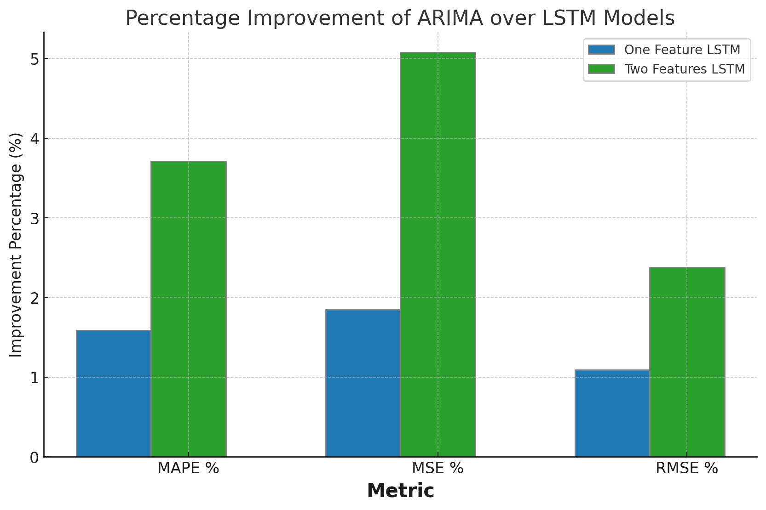
Comparative Analysis
Metric | LSTM (1 Feature) (%) | LSTM (2 Features) (%)
MAPE | 1.59% | 3.71%
MSE | 1.85% | 5.08%
RMSE | 1.09% | 2.38%
The percentage improvement of ARIMA over LSTM
18

Slide 19
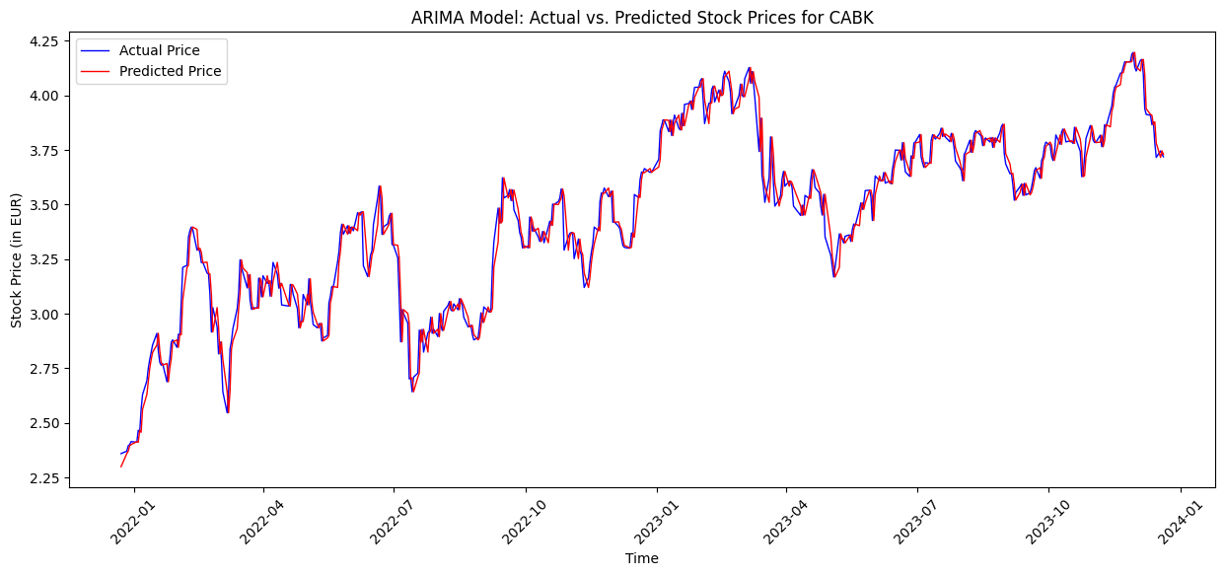
Caixabank Performance of ARIMA
Metric | Value
MSE | 0.00465
RMSE | 0.06822
MAPE | 1.50960
19

Slide 20
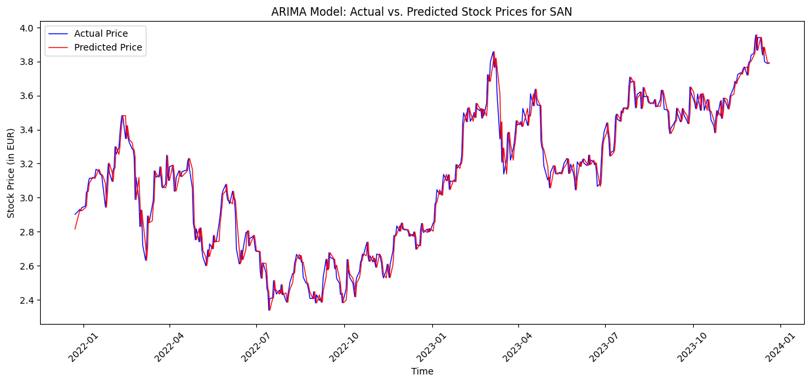
Santander Performance of ARIMA
Metric | Value
MSE | 0.00387
RMSE | 0.06226
MAPE | 1.51783
20

Slide 21
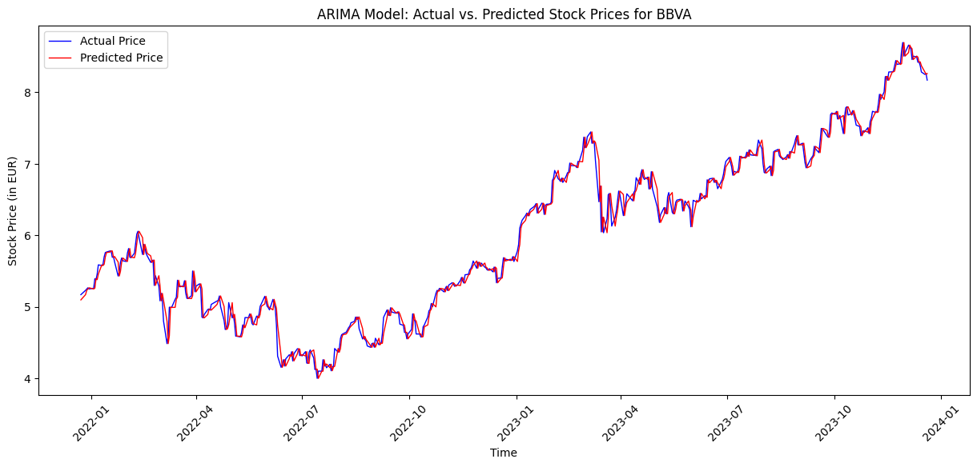
BBVA Performance of ARIMA
Metric | Value
MSE | 0.01306
RMSE | 0.11428
MAPE | 1.41255
21

Slide 22
Conclusion
ARIMA model was more effective than LSTM models in forecasting stock prices
Using Close price as a solo feature in ARIMA yielded more accurate forecasts than LSTM
ARIMA (0, 1, 0) was the best-performing model
One feature LSTM optimal parameters are 4-34 units and 100-150 epochs
Two features LSTM optimal parameters are 50-80 units and 150 epochs
22

Slide 23
Limitations
Findings are specific to the Spanish banking sector and may not apply to other markets.
Historical data usage may not fully capture future market changes, affecting accuracy.
23

Slide 24
The development of hybrid ARIMA-LSTM models
Extending these models to different sectors or regions
Future Work
24

Slide 25
References
Agrawal, Manish, Khan, D.A.U. and Shukla, D.P.K. (2019) ‘Stock price prediction using technical indicators: a predictive model using optimal deep learning’, International Journal of Recent Technology and Engineering (IJRTE), 8(2), pp. 2297–2305. Available at: https://doi.org/10.35940/ijrteB3048.078219.
Alzheev, A.V. and Kochkarov, R.A. (2020) ‘Comparative analysis of arima and lstm predictive models: evidence from russian stocks’, Finance: Theory and Practice, 24(1), pp. 14–23. Available at: https://doi.org/10.26794/2587-5671-2020-24-1-14-23.
Ariyo, A.A., Adewumi, A.O. and Ayo, C.K. (2014) ‘Stock price prediction using the arima model’, in 2014 UKSim-AMSS 16th International Conference on Computer Modelling and Simulation. Cambridge, United Kingdom: IEEE, pp. 106–112. Available at: https://doi.org/10.1109/UKSim.2014.67.
Ashok, A. and Prathibhamol, C.P. (2021) ‘Improved analysis of stock market prediction:(Arima-lstm-smp)’, in 2021 4th Biennial International Conference on Nascent Technologies in Engineering (ICNTE). NaviMumbai, India: IEEE, pp. 1–5. Available at: https://doi.org/10.1109/ICNTE51185.2021.9487745.
Banco bilbao vizcaya argentaria, s. A.(Bbva. Mc) Stock price, news, quote & history - yahoo finance (no date). Available at: https://finance.yahoo.com/quote/BBVA.MC/ (Accessed: 24 November 2023).
Banco santander, s. A.(San. Mc) Stock price, news, quote & history - yahoo finance (no date). Available at: https://finance.yahoo.com/quote/SAN.MC/ (Accessed: 24 November 2023).
Caixabank, s. A.(Cabk. Mc) Stock price, news, quote & history - yahoo finance (no date). Available at: https://finance.yahoo.com/quote/CABK.MC/ (Accessed: 24 November 2023).
Choi, J.W. and Choi, Y. (2023) ‘A study of prediction of airline stock price through oil price with long short-term memory model’, International Journal of Advanced Computer Science and Applications, 14(5). Available at: https://doi.org/10.14569/IJACSA.2023.0140509.
25

Slide 26
References
Htun, H.H., Biehl, M. and Petkov, N. (2023) ‘Survey of feature selection and extraction techniques for stock market prediction’, Financial Innovation, 9(1), p. 26. Available at: https://doi.org/10.1186/s40854-022-00441-7.
Kobiela, D. et al. (2022) ‘ARIMA vs LSTM on NASDAQ stock exchange data’, Procedia Computer Science, 207, pp. 3836–3845. Available at: https://doi.org/10.1016/j.procs.2022.09.445.
Largest spanish (Ibex) banks stocks by market cap (no date) Simply Wall St. Available at: https://simplywall.st/stocks/es/banks/market-cap-large (Accessed: 24 November 2023).
Ma, Q. (2020) ‘Comparison of arima, ann and lstm for stock price prediction’, E3S Web of Conferences. Edited by S.O. Oladokun and S. Lu, 218, p. 01026. Available at: https://doi.org/10.1051/e3sconf/202021801026.
Mondal, P., Shit, L. and Goswami, S. (2014) ‘Study of effectiveness of time series modeling (Arima) in forecasting stock prices’, International Journal of Computer Science, Engineering and Applications, 4(2), pp. 13–29. Available at: https://doi.org/10.5121/ijcsea.2014.4202.
Roondiwala, M., Patel, H. and Varma, S. (2015). Predicting Stock Prices Using LSTM. International Journal of Science and Research (IJSR) ISSN, [online] 6, pp.2319–7064. Available at: https://www.ijsr.net/archive/v6i4/ART20172755.pdf.
Siami-Namini, S., Tavakoli, N. and Siami Namin, A. (2018) ‘A comparison of arima and lstm in forecasting time series’, in 2018 17th IEEE International Conference on Machine Learning and Applications (ICMLA). Orlando, FL: IEEE, pp. 1394–1401. Available at: https://doi.org/10.1109/ICMLA.2018.00227.
Swathi, T., Kasiviswanath, N. and Rao, A.A. (2022) ‘An optimal deep learning-based LSTM for stock price prediction using twitter sentiment analysis’, Applied Intelligence, 52(12), pp. 13675–13688. Available at: https://doi.org/10.1007/s10489-022-03175-2.
Toprak, Ş., Çağil, G. and Kökçam, A.H. (2023) ‘Stock closing price prediction with machine learning algorithms: petkm stock example in bist’, Düzce Üniversitesi Bilim ve Teknoloji Dergisi, 11(2), pp. 958–976. Available at: https://doi.org/10.29130/dubited.1096767.
Wong, W.-K., Manzur, M. and Chew, B.-K. (2003) ‘How rewarding is technical analysis? Evidence from Singapore stock market’, Applied Financial Economics, 13(7), pp. 543–551. Available at: https://doi.org/10.1080/0960310022000020906
26

Slide 27

Thank You
27

